Slide 1
BirdSong Sonatas
MIDS 207 Final Project - Baseline
Rachel Gao
Amina Alavi
Hamsini Sankaran
Andrew Loeber
Notes:
Hi everyone, thank you for joining us today. I’m here with Amina, Hamsini, and Andrew as BirdSong Sonatas to present the baseline presentation for our final project.

Slide 2
Motivation & Objective

Slide 3
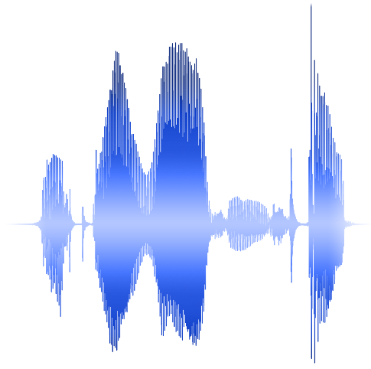
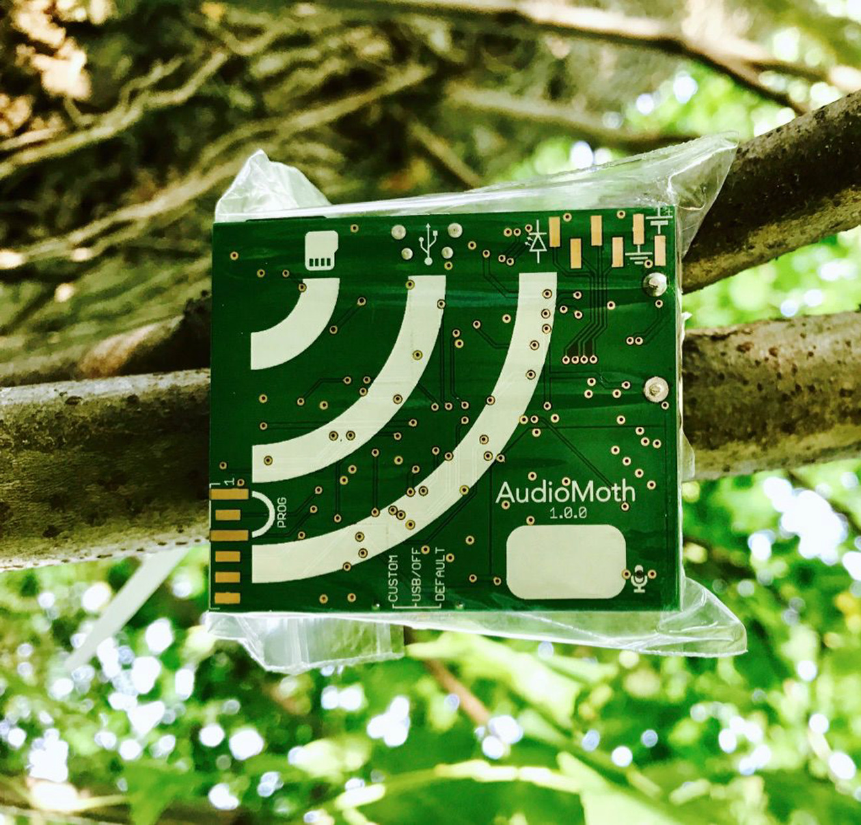
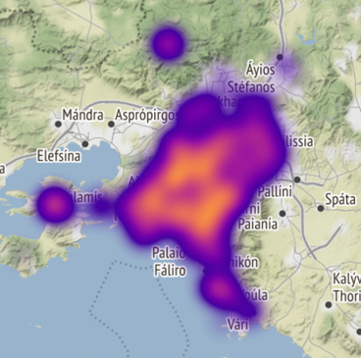
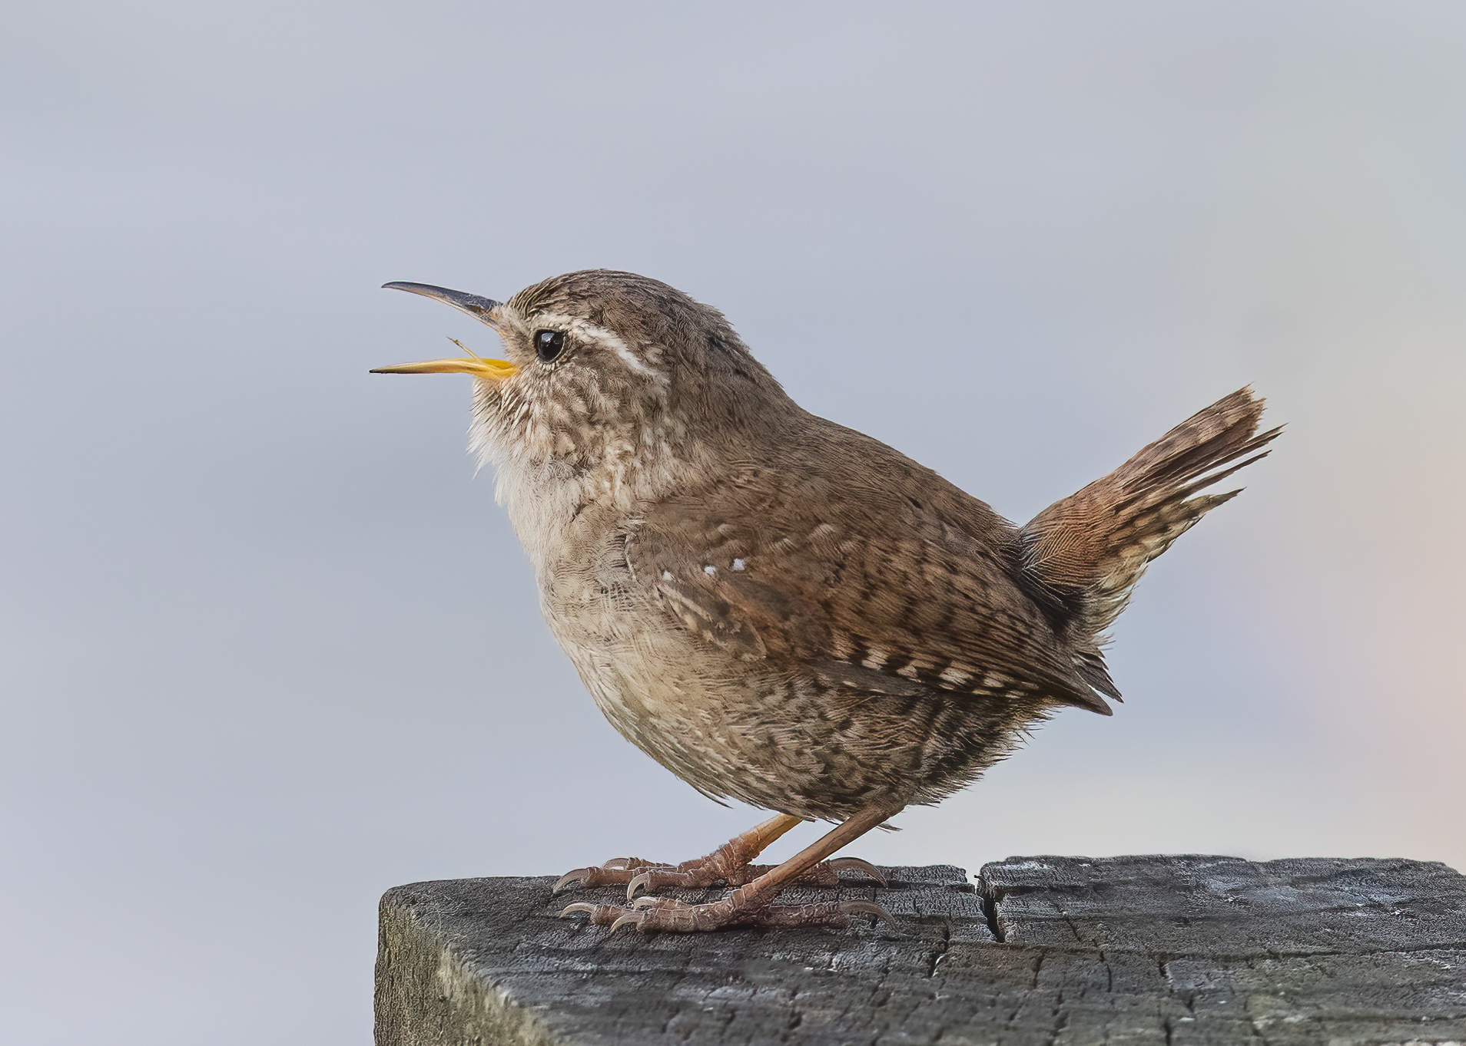

Motivation & Objective
Birds are an important indicator of habitat biodiversity
Traditional surveying methods are expensive to conduct on a frequent basis
Passive acoustic monitoring via remotely-placed microphones offers conservation efforts an enticing low-cost alternative
Success of this approach hinges on being able to accurately identify which bird species are present in audio recordings
Notes:
Birds, as inhabitants of our natural world, play a crucial role as indicators of habitat biodiversity. However, conducting traditional observer-based surveys over vast areas can be expensive and logistically challenging.
Therefore, for our final project, we propose a machine learning-based approach that can identify bird species using audio recordings. By utilizing passive acoustic monitoring, scientists can explore the relationship between restoration interventions and biodiversity on a larger scale, with greater precision, and at a lower cost.

Slide 4
Dataset

Slide 5
Dataset
Dataset Source | BirdCLEF 2023 on Kaggle
Data Source | xenocanto.org
Number of Instances | 16,941 rows
Number of Species | 264 species
Primary Features | Short recordings of individual bird calls with identified bird species
Additional Features | Secondary bird species, Call type, Location, Author, License, URL, Quality rating, Taxonomy
Notes:
To embark on our project, we have chosen the BirdCLEF 2023 dataset from a Kaggle competition. This dataset consists of short recordings capturing individual bird calls with identified bird species, accompanied by information such as call type and location. These recordings and metadata have been sourced from xenocanto.org, a platform where enthusiasts share labeled recordings of bird calls.
Since the competition's test dataset lacks labels, we will use only the training dataset for our project. In total, the dataset has nearly 17 thousand rows, encompassing more than 200 bird species. To produce generalizable results, we will split the dataset into training, validation, and test sets.

Slide 6
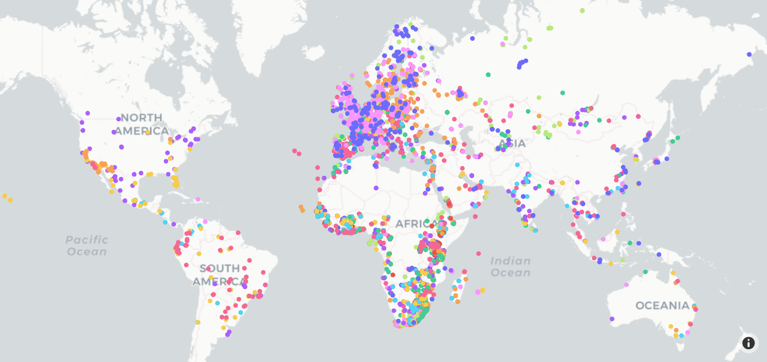
Bird Species World Map
Notes:
Let us take a look at the origins of our birds. On this world map, each bird species is represented by a unique colored dot. We can see that there is a substantial concentration of birds from Europe, closely followed by Africa. Some species are evenly distributed across the entire globe, while others are more concentrated in certain continents.
With such diverse species in our data, we naturally face hurdles due to the abundance of diversity. I will now pass this to Amina to discuss the species we have chosen as our project's class labels.

Slide 7
Class Labels

Slide 8
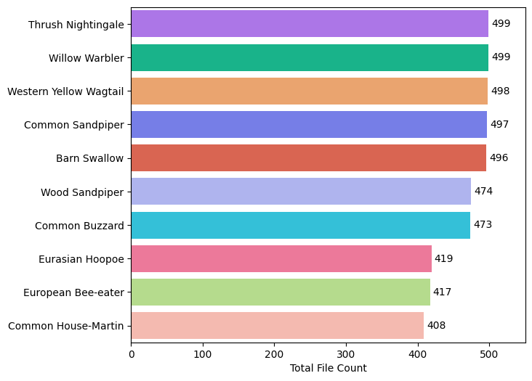
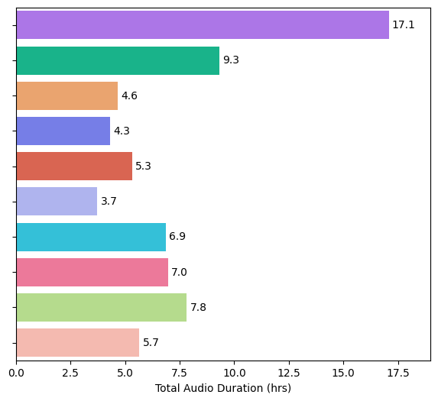
Top 10 Bird Species - Sample Size
4,680 recordings
71.7 hours of audio
Notes:
Briefly discuss class imbalance & how it’s more pronounced in total audio duration than file count

Slide 9
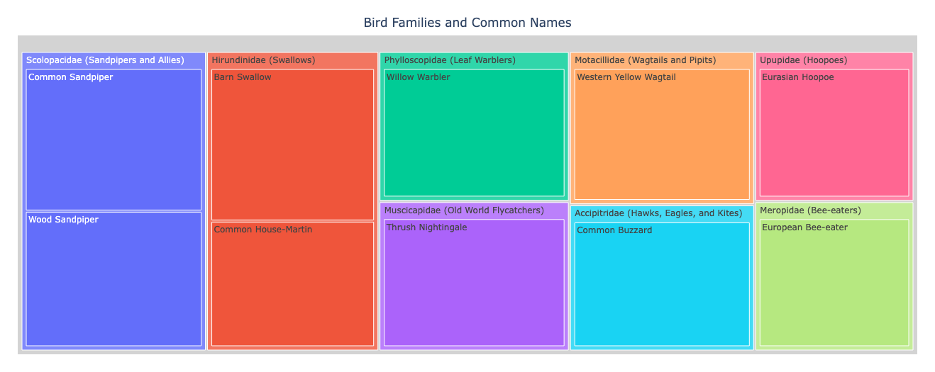
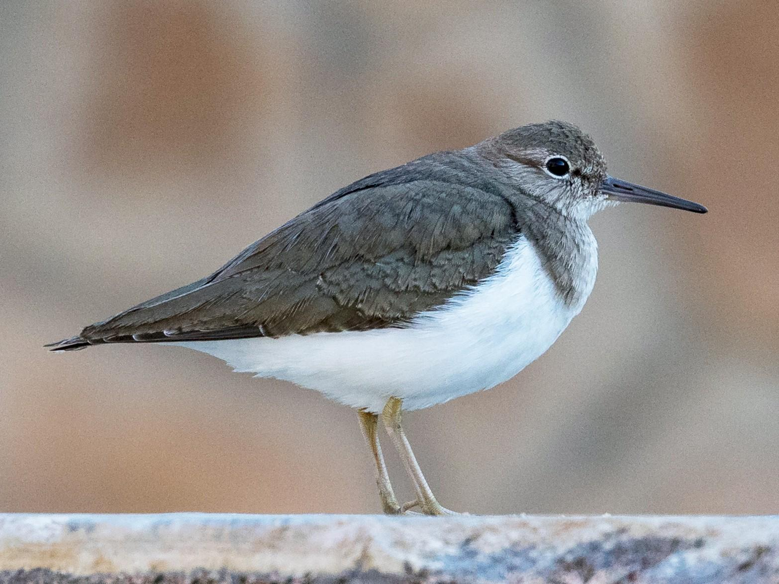
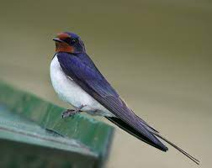
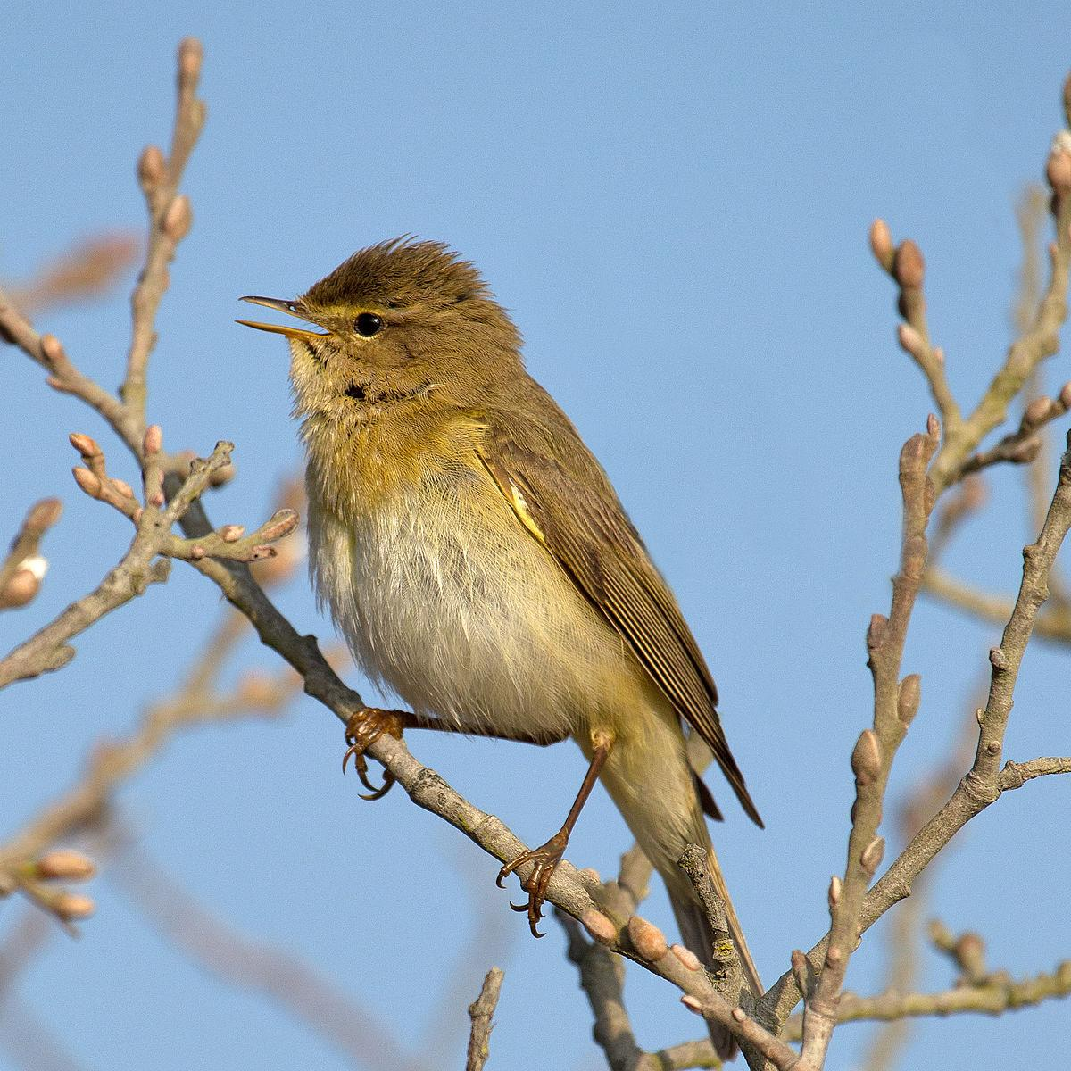
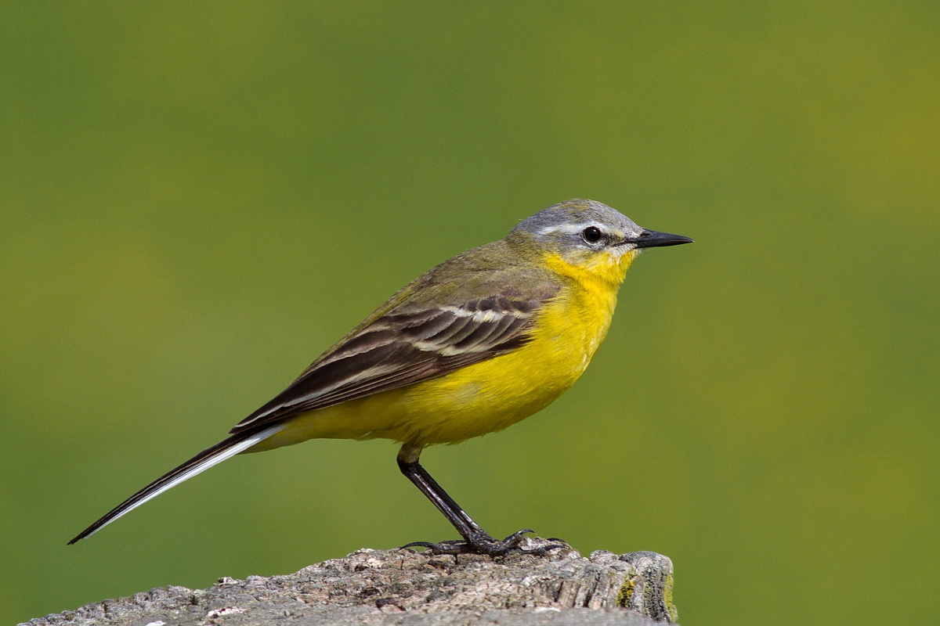
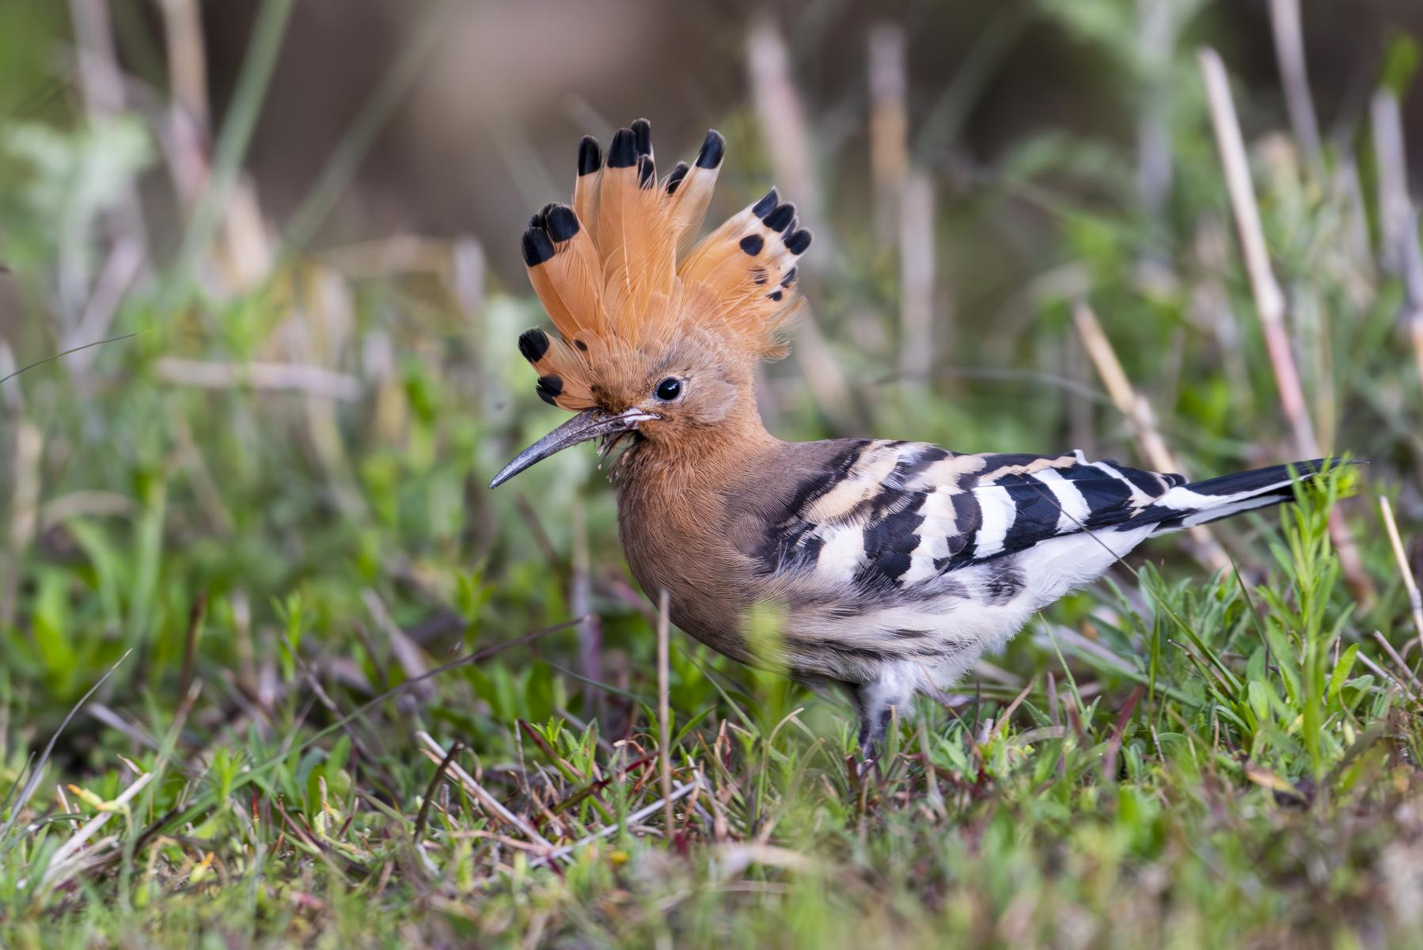
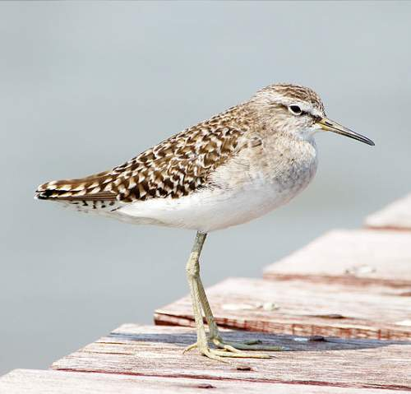
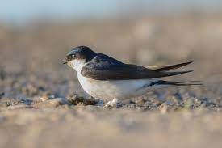
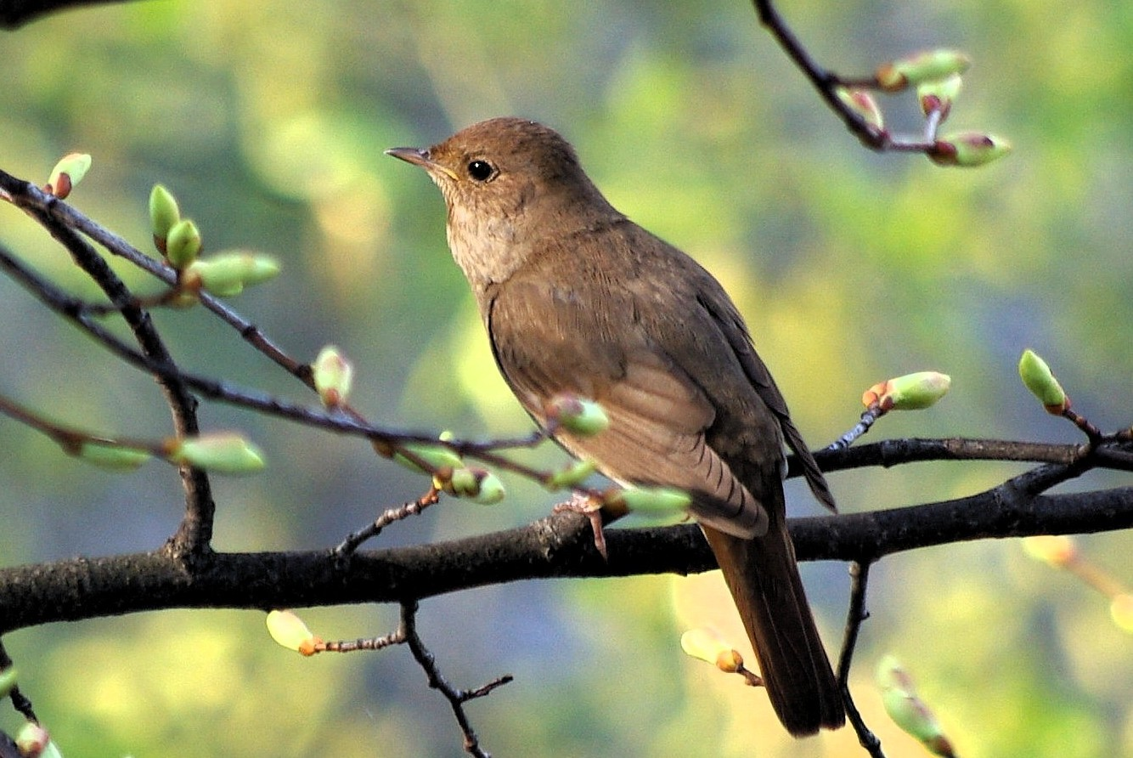
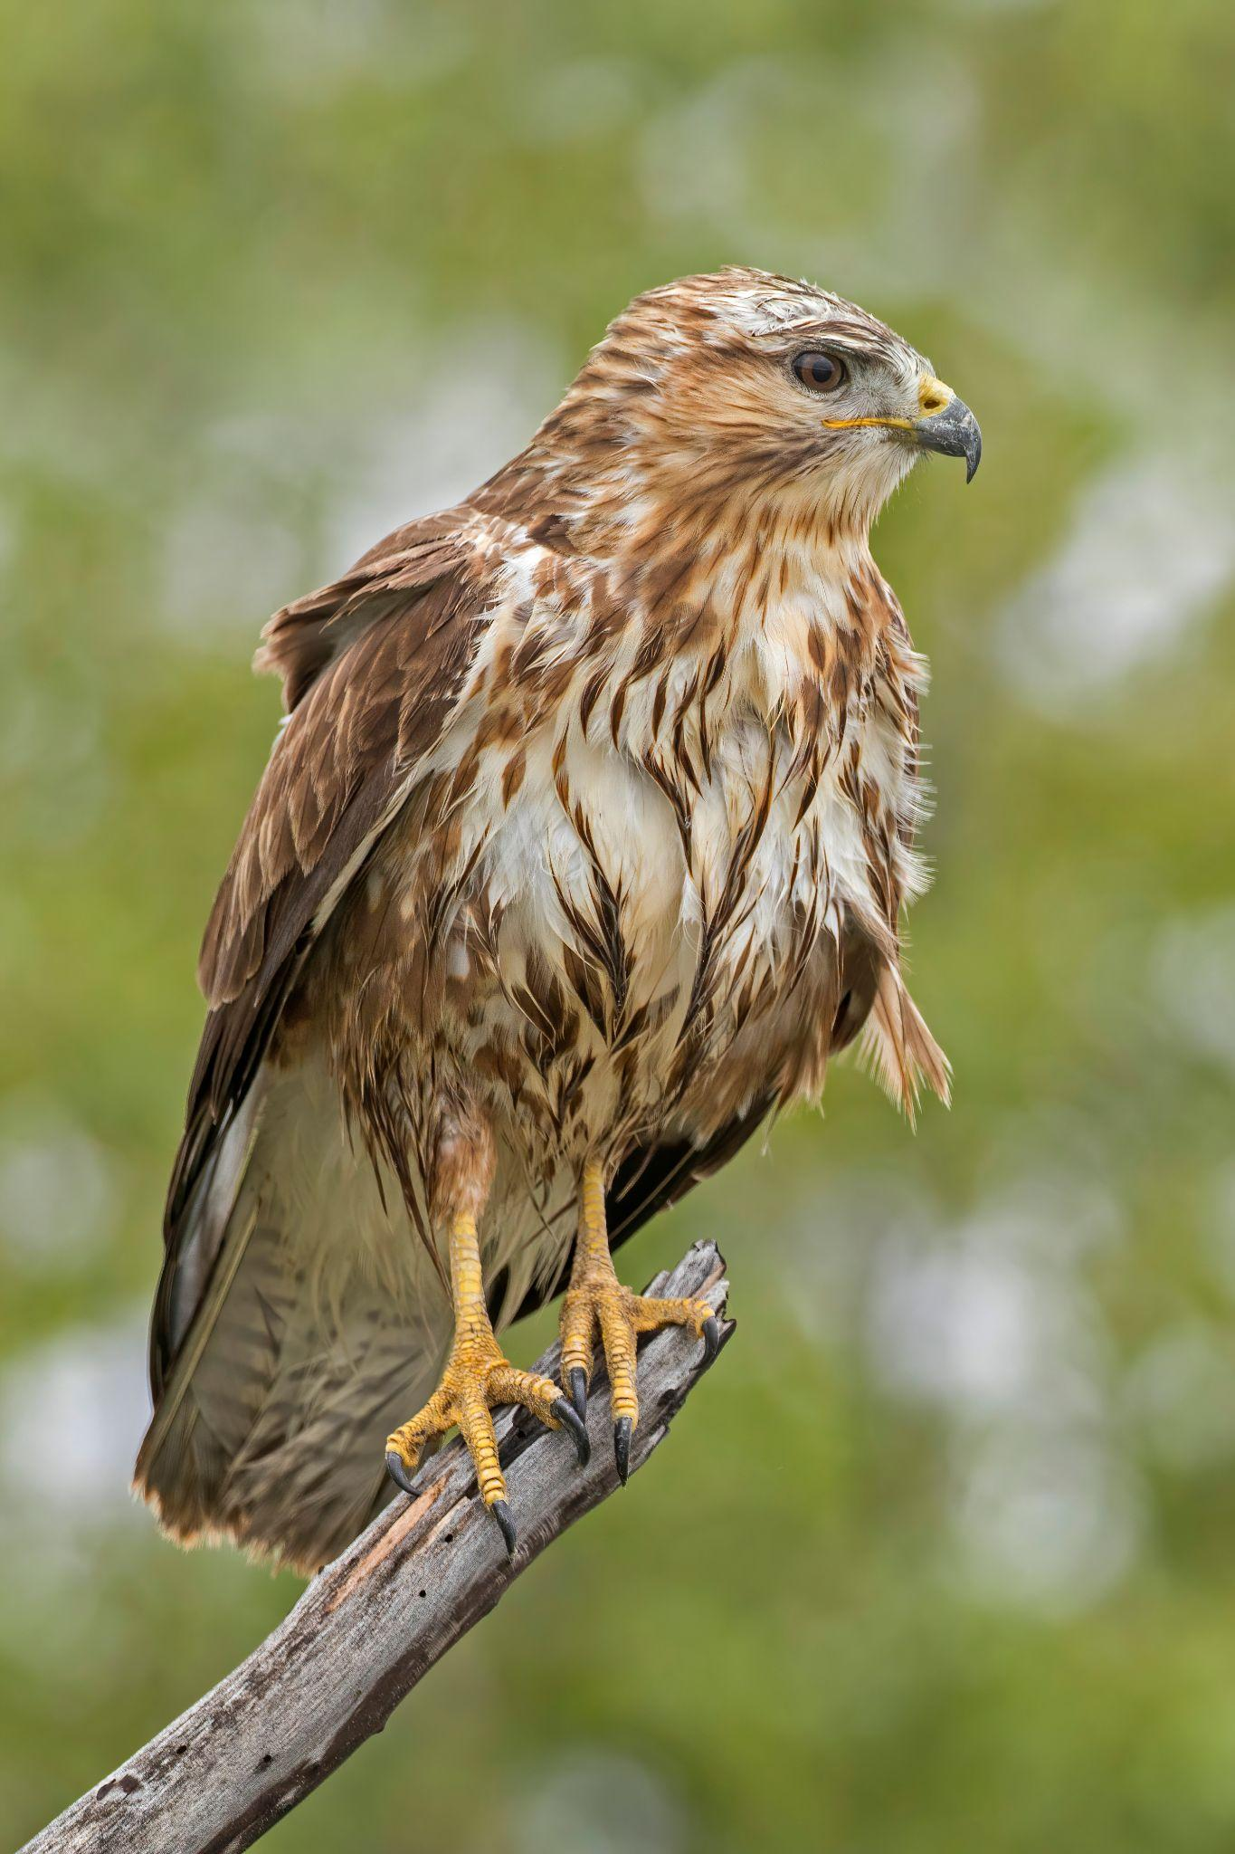
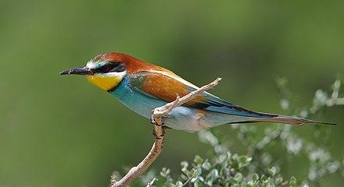
Top 10 Bird Species - Taxonomy

Slide 10
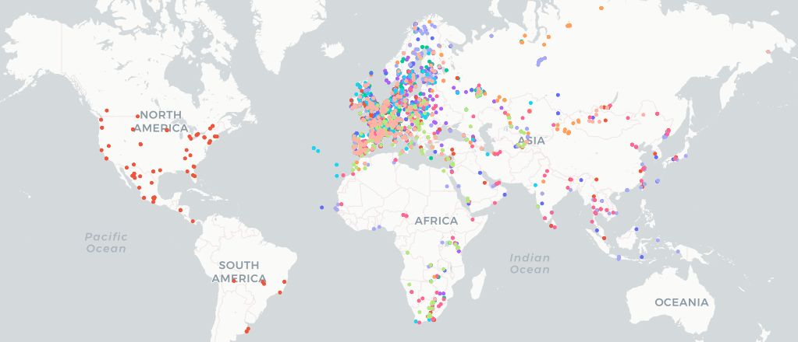
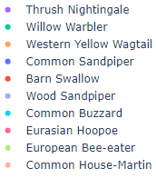
Top 10 Bird Species - World Map

Slide 11
Features

Slide 12
Feature Selection
 | Use embeddings from a pre-trained bird vocalization model | Directly extract features from audio
Pros | Accepts raw audio as input Embedding output reduces the amount of feature engineering required and ensures reasonable accuracy | No data leakage Flexible input audio length Full visibility and control of input features and architecture
Cons | Possible data leakage 5-second audio inputs required Low visibility into model architecture, training process, and sources of bias | Substantial feature engineering required Sound-based modeling is a niche topic in ML More difficult to achieve high accuracy and generalizable models

Slide 13

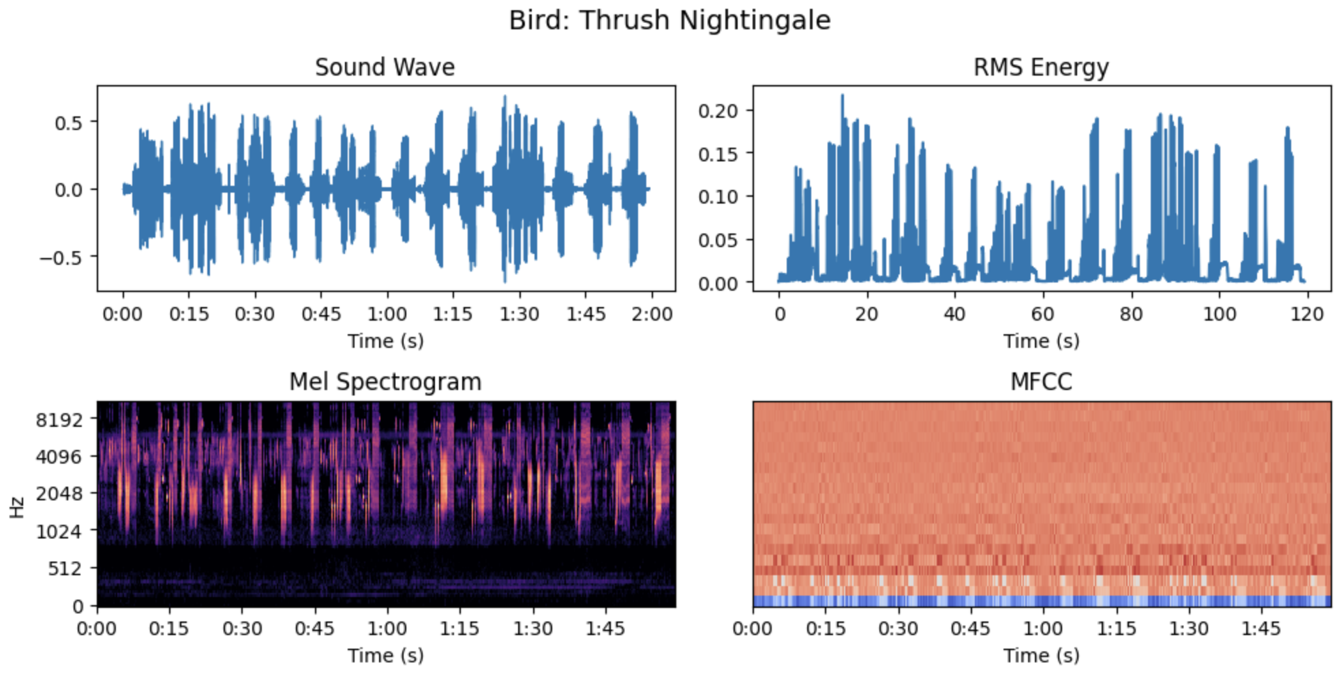

Slide 14
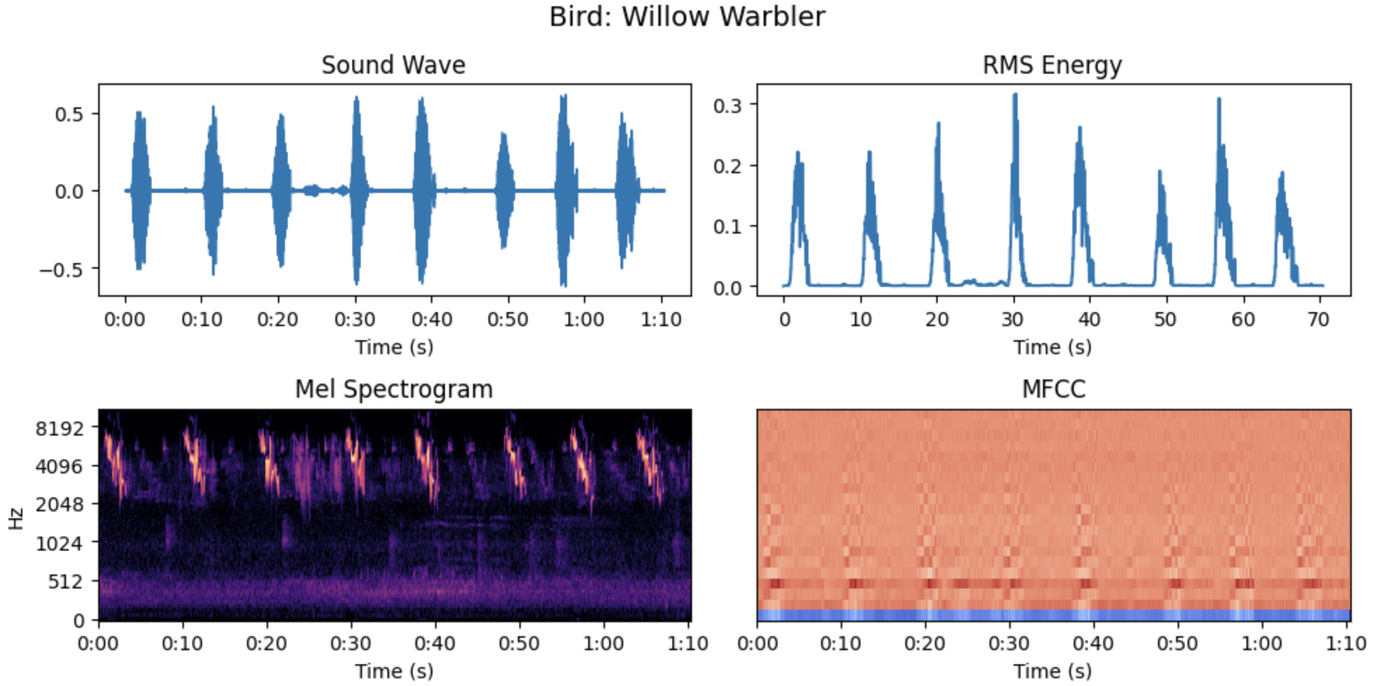

Slide 15
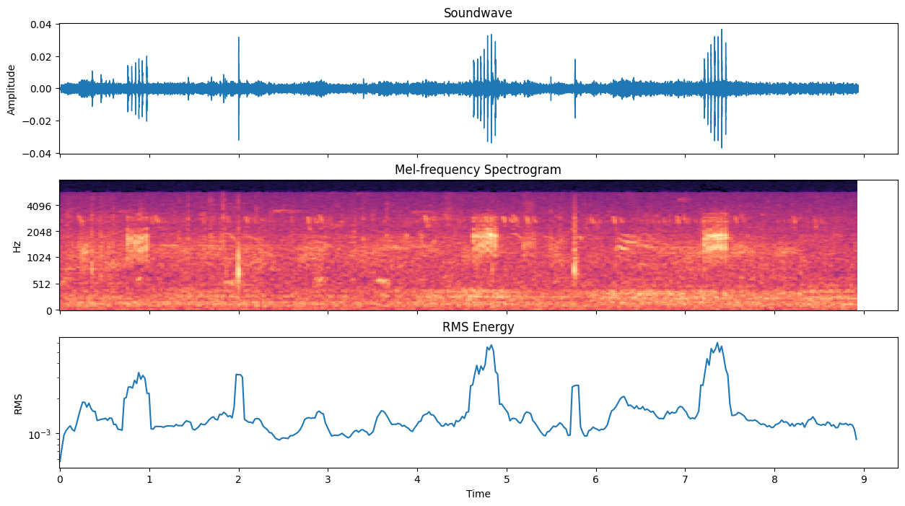
Feature Extraction
Extract loudest n seconds from each audio based on RMS value?
Extract random n seconds from each audio to account for value-adding noise?
Split each audio to n second chunks with m seconds overlap to create more training data?
PCA, normalization, average MFCC mean?
Others?

Slide 16
Architecture & Evaluation Metrics

Slide 17
Challenges | Possible Solutions
Dataset is larger than available RAM on Colab | Use only a portion of the available recordings File streaming Downsample from 32 to 16 KHz (or lower)
Loading audio to memory is very slow | Store audio as numpy (.npy) files
Some recordings are much longer than others | Throw away any under 5 seconds Select only portions of longer recordings
Total recording duration varies significantly by class | Select equal number of sample clips from each class Apply class-based loss scaling during training

Slide 18
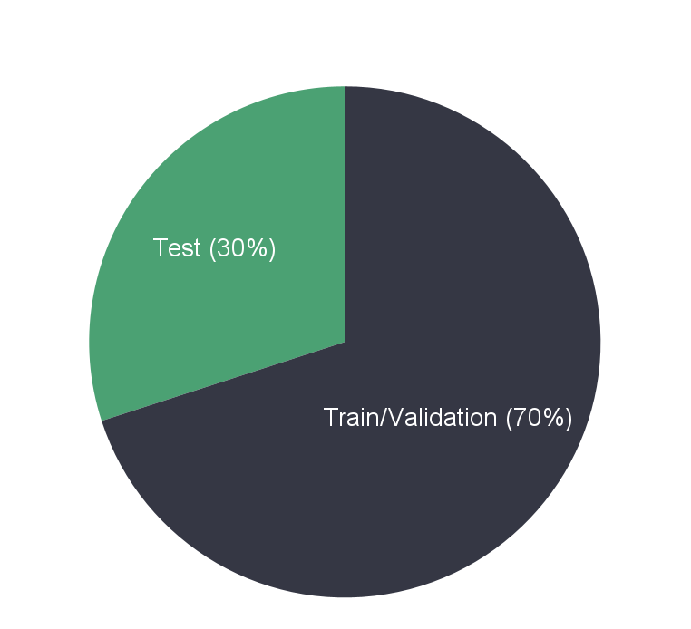

Train/Test Split
Thrush
Nightingale
Willow Warbler
Western Yellow Wagtail
. . .
. . .
Notes:
Stratify by specie, 30% for each species

Slide 19

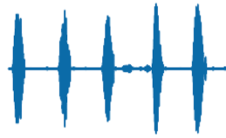
1D Convolutional Neural Network
. . .
Thrush Nightingale
Willow Warbler
Western Yellow Wagtail
Common Sandpiper
Barn Swallow
2D Convolutional Neural Network
Long Short-Term Memory
……
……
Random Forest Classifier
. . .
Soundwave
Feature Extraction &
Augmentations
Machine Learning Model
Bird Species
Prediction

Slide 20
Evaluation Metrics
Mean Cross Entropy Loss
&
F-1 Score
Overall Level
&
Class Level
@
Confusion Matrix
Notes:
Can discuss further later, just putting an idea down for now
A good reference for multi-class evaluation: https://www.evidentlyai.com/classification-metrics/multi-class-metrics#:~:text=In%20the%20first%20case%2C%20you,to%20get%20a%20single%20number.

Slide 21
Thank you!

